Slide 1
Dynamic Programming

Slide 2
Dynamic Programming
An algorithm design technique (like divide and conquer)
Divide and conquer
  Partition the problem into independent subproblems
  Solve the subproblems recursively
  Combine the solutions to solve the original problem

Slide 3
Dynamic Programming
Applicable when subproblems are not independent
  Subproblems share subsubproblems
E.g.: Combinations:
  A divide and conquer approach would repeatedly solve the common subproblems
  Dynamic programming solves every subproblem just once and stores the answer in a table
n
k
=
n-1
k
n-1
k-1
+
n
1
=1
n
n
=1

Slide 4
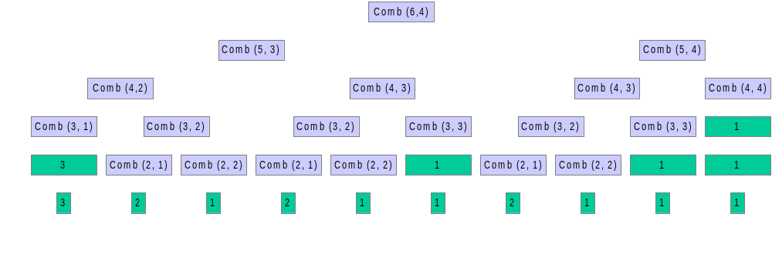
Example: Combinations
n
k
=
n-1
k
n-1
k-1
+

Slide 5
Dynamic Programming
Used for optimization problems
  A set of choices must be made to get an optimal solution
  Find a solution with the optimal value (minimum or maximum)
  There may be many solutions that lead to an optimal value
  Our goal: find an optimal solution

Slide 6
Dynamic Programming Algorithm
Characterize the structure of an optimal solution
Recursively define the value of an optimal solution
Compute the value of an optimal solution in a bottom-up fashion
Construct an optimal solution from computed information (not always necessary)

Slide 7
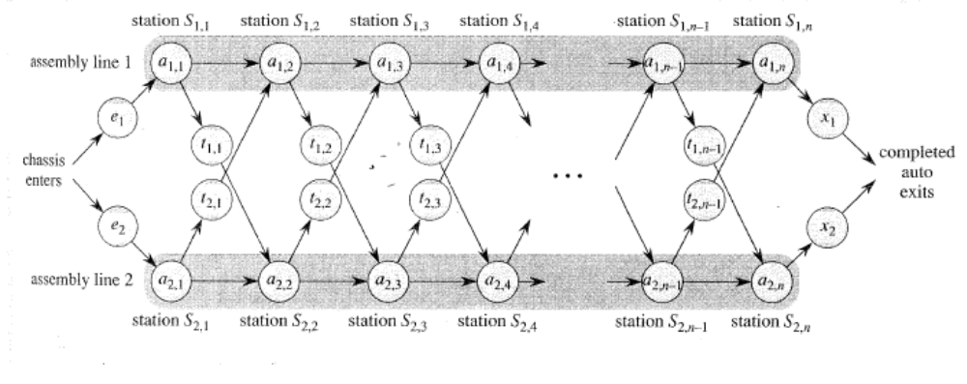
Assembly Line Scheduling
Automobile factory with two assembly lines
  Each line has n stations: S_{1,1}, . . . , S_{1,n} and S_{2,1}, . . . , S_{2,n}
  Corresponding stations S_{1, j} and S_{2, j} perform the same function but can take different amounts of time a_{1, j} and a_{2, j}
  Entry times are: e₁ and e₂; exit times are: x₁ and x₂

Slide 8
Assembly Line Scheduling
After going through a station, can either:
  stay on same line at no cost, or
  transfer to other line: cost after S_{i,j} is t_{i,j} , j = 1, . . . , n - 1

Slide 9
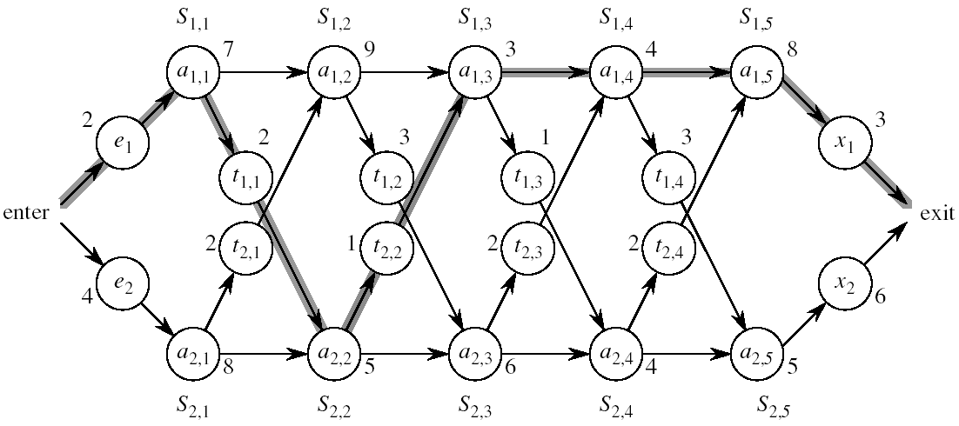
Assembly Line Scheduling
Problem:
what stations should be chosen from line 1 and which from line 2 in order to minimize the total time through the factory for one car?

Slide 10
One Solution
Brute force
  Enumerate all possibilities of selecting stations
  Compute how long it takes in each case and choose the best one
Solution:
  There are 2^{n} possible ways to choose stations
  Infeasible when n is large!!
1
2
3
4
n
1
0
0
1
1
0 if choosing line 2
at step j (= 3)
1 if choosing line 1
at step j (= n)

Slide 11
1. Structure of the Optimal Solution
How do we compute the minimum time of going through a station?

Slide 12
1. Structure of the Optimal Solution
Let’s consider all possible ways to get from the starting point through station S_{1,j}
  We have two choices of how to get to S_{1, j}:
    Through S_{1, j - 1}, then directly to S_{1, j}
    Through S_{2, j - 1}, then transfer over to S_{1, j}
S_{1,j-1}
S_{1,j}
Line 1
a_{1,j-1}
a_{1,j}
t_{2,j-1}
Line 2
a_{2,j-1}
S_{2,j-1}

Slide 13
1. Structure of the Optimal Solution
Suppose that the fastest way through S_{1, j} is through S_{1, j – 1}
  We must have taken a fastest way from entry through S_{1, j – 1}
  If there were a faster way through S_{1, j - 1}, we would use it instead
Similarly for S_{2, j – 1}
S_{1,j-1}
S_{1,j}
Line 1
a_{1,j-1}
a_{1,j}
Optimal Substructure
t_{2,j-1}
a_{2,j-1}
Line 2
S_{2,j-1}

Slide 14
Optimal Substructure
Generalization: an optimal solution to the problem “find the fastest way through S_{1, j}” contains within it an optimal solution to subproblems: “find the fastest way through S_{1, j - 1} or S_{2, j – 1}”.
This is referred to as the optimal substructure property
We use this property to construct an optimal solution to a problem from optimal solutions to subproblems

Slide 15
2. A Recursive Solution
Define the value of an optimal solution in terms of the optimal solution to subproblems

Slide 16
2. A Recursive Solution (cont.)
Definitions:
  f* : the fastest time to get through the entire factory
  f_{i}[j] : the fastest time to get from the starting point through station S_{i,j}
  f* = min (f₁[n] + x₁, f₂[n] + x₂)

Slide 17
2. A Recursive Solution (cont.)
Base case: j = 1, i=1,2 (getting through station 1)
f₁[1] = e₁ + a_{1,1}
f₂[1] = e₂ + a_{2,1}

Slide 18
2. A Recursive Solution (cont.)
General Case: j = 2, 3, …,n, and i = 1, 2
Fastest way through S_{1, j} is either:
  the way through S_{1, j - 1} then directly through S_{1, j}, or
  f₁[j - 1] + a_{1,j}
  the way through S_{2, j - 1}, transfer from line 2 to line 1, then through S_{1, j}
f₂[j -1] + t_{2,j-1} + a_{1,j}
f₁[j] = min(f₁[j - 1] + a_{1,j} ,f₂[j -1] + t_{2,j-1} + a_{1,j})
S_{1,j-1}
S_{1,j}
Line 1
a_{1,j-1}
a_{1,j}
t_{2,j-1}
a_{2,j-1}
Line 2
S_{2,j-1}

Slide 19
2. A Recursive Solution (cont.)
e₁ + a_{1,1} if j = 1
f₁[j] =
min(f₁[j - 1] + a_{1,j} ,f₂[j -1] + t_{2,j-1} + a_{1,j}) if j ≥ 2
e₂ + a_{2,1} if j = 1
f₂[j] =
min(f₂[j - 1] + a_{2,j} ,f₁[j -1] + t_{1,j-1} + a_{2,j}) if j ≥ 2

Slide 20
3. Computing the Optimal Solution
  f* = min (f₁[n] + x₁, f₂[n] + x₂)
f₁[j] = min(f₁[j - 1] + a_{1,j} ,f₂[j -1] + t_{2,j-1} + a_{1,j})
f₂[j] = min(f₂[j - 1] + a_{2,j} ,f₁[j -1] + t_{1,j-1} + a_{2,j})
Solving top-down would result in exponential running time
1
2
3
4
5
f₁[j]
f₁(1)
f₁(2)
f₁(3)
f₁(4)
f₁(5)
f₂[j]
f₂(1)
f₂(2)
f₂(3)
f₂(4)
f₂(5)
4 times
2 times

Slide 21
3. Computing the Optimal Solution
For j ≥ 2, each value f_{i}[j] depends only on the values of f₁[j – 1] and f₂[j - 1]
Idea: compute the values of f_{i}[j] as follows:
Bottom-up approach
  First find optimal solutions to subproblems
  Find an optimal solution to the problem from the subproblems
in increasing order of j
1
2
3
4
5
f₁[j]
f₂[j]

Slide 22
Example
e₁ + a_{1,1}, if j = 1
f₁[j] = min(f₁[j - 1] + a_{1,j} ,f₂[j -1] + t_{2,j-1} + a_{1,j}) if j ≥ 2
1
2
3
4
5
f₁[j]
9
18^{[1]}
20^{[2]}
24^{[1]}
32^{[1]}
f* = 35^{[1]}
f₂[j]
12
16^{[1]}
22^{[2]}
25^{[1]}
30^{[2]}

Slide 23
FASTEST-WAY(a, t, e, x, n)
f₁[1] ← e₁ + a_{1,1}
f₂[1] ← e₂ + a_{2,1}
for j ← 2 to n
do if f₁[j - 1] + a_{1,j} ≤ f₂[j - 1] + t_{2, j-1} + a_{1, j}
then f₁[j] ← f₁[j - 1] + a_{1, j}
l₁[j] ← 1
else f₁[j] ← f₂[j - 1] + t_{2, j-1} + a_{1, j}
l₁[j] ← 2
if f₂[j - 1] + a_{2, j} ≤ f₁[j - 1] + t_{1, j-1} + a_{2, j}
then f₂[j] ← f₂[j - 1] + a_{2, j}
l₂[j] ← 2
else f₂[j] ← f₁[j - 1] + t_{1, j-1} + a_{2, j}
l₂[j] ← 1
Compute initial values of f₁ and f₂
O(N)
Compute the values of
f₁[j] and l₁[j]
Compute the values of
f₂[j] and l₂[j]

Slide 24
FASTEST-WAY(a, t, e, x, n) (cont.)
if f₁[n] + x₁ ≤ f₂[n] + x₂
then f* = f₁[n] + x₁
l* = 1
else f* = f₂[n] + x₂
l* = 2
Compute the values of
the fastest time through the
entire factory

Slide 25
4. Construct an Optimal Solution
Alg.: PRINT-STATIONS(l, n)
i ← l*
print “line ” i “, station ” n
for j ← n downto 2
do i ←l_{i}[j]
print “line ” i “, station ” j - 1
1
2
3
4
5
f₁[j]/l₁[j]
9
18^{[1]}
20^{[2]}
24^{[1]}
32^{[1]}
l* = 1
f₂[j]/l₂[j]
12
16^{[1]}
22^{[2]}
25^{[1]}
30^{[2]}

Slide 26
Matrix-Chain Multiplication
Problem: given a sequence ⟨A₁, A₂, …, A_{n}⟩, compute the product:
A₁ ⋅ A₂ ⋅⋅⋅ A_{n}
Matrix compatibility:
C = A ⋅ B C=A₁ ⋅ A₂ ⋅⋅⋅ A_{i} ⋅ A_{i+1} ⋅⋅⋅ A_{n}
col_{A} = row_{B} col_{i} = row_{i+1}
row_{C} = row_{A} row_{C} = row_{A1}
col_{C} = col_{B} col_{C} = col_{An}

Slide 27
MATRIX-MULTIPLY(A, B)
if columns[A] ≠ rows[B]
then error “incompatible dimensions”
else for i ← 1 to rows[A]
do for j ← 1 to columns[B]
do C[i, j] = 0
for k ← 1 to columns[A]
do C[i, j] ← C[i, j] + A[i, k] B[k, j]
rows[A] ⋅ cols[A] ⋅ cols[B]
multiplications
k
j
cols[B]
j
cols[B]
i
*
=
i
k
A
B
C
rows[A]
rows[A]

Slide 28
Matrix-Chain Multiplication
In what order should we multiply the matrices?
A₁ ⋅ A₂ ⋅⋅⋅ A_{n}
Parenthesize the product to get the order in which matrices are multiplied
E.g.: A₁ ⋅ A₂ ⋅ A₃ = ((A₁ ⋅ A₂) ⋅ A₃)
= (A₁ ⋅ (A₂ ⋅ A₃))
Which one of these orderings should we choose?
  The order in which we multiply the matrices has a significant impact on the cost of evaluating the product

Slide 29
Example
A₁ ⋅ A₂ ⋅ A₃
A₁: 10 x 100
A₂: 100 x 5
A₃: 5 x 50
1. ((A₁ ⋅ A₂) ⋅ A₃): A₁ ⋅ A₂ = 10 x 100 x 5 = 5,000 (10 x 5)
((A₁ ⋅ A₂) ⋅ A₃) = 10 x 5 x 50 = 2,500
Total: 7,500 scalar multiplications
2. (A₁ ⋅ (A₂ ⋅ A₃)): A₂ ⋅ A₃ = 100 x 5 x 50 = 25,000 (100 x 50)
(A₁ ⋅ (A₂ ⋅ A₃)) = 10 x 100 x 50 = 50,000
Total: 75,000 scalar multiplications
one order of magnitude difference!!

Slide 30
Matrix-Chain Multiplication:
Problem Statement
Given a chain of matrices ⟨A₁, A₂, …, A_{n}⟩, where A_{i} has dimensions p_{i-1}x p_{i}, fully parenthesize the product A₁ ⋅ A₂ ⋅⋅⋅ A_{n} in a way that minimizes the number of scalar multiplications.
A₁ ⋅ A₂ ⋅⋅⋅ A_{i} ⋅ A_{i+1} ⋅⋅⋅ A_{n}
p₀ x p₁ p₁ x p₂ p_{i-1} x p_{i} p_{i} x p_{i+1} p_{n-1} x p_{n}

Slide 31
What is the number of possible parenthesizations?
Exhaustively checking all possible parenthesizations is not efficient!
It can be shown that the number of parenthesizations grows exponentially

Slide 32
1. The Structure of an Optimal Parenthesization
Notation:
A_{i…j} = A_{i} A_{i+1} ⋅⋅⋅ A_{j}, i ≤ j
Suppose that an optimal parenthesization of A_{i…j} splits the product between A_{k} and A_{k+1}, where i ≤ k < j
A_{i…j} = A_{i} A_{i+1} ⋅⋅⋅ A_{j}
= A_{i} A_{i+1} ⋅⋅⋅ A_{k} A_{k+1} ⋅⋅⋅ A_{j}
= A_{i…k} A_{k+1…j}

Slide 33
Optimal Substructure
A_{i…j} = A_{i…k} A_{k+1…j}
The parenthesization of the “prefix” A_{i…k} must be an optimal parentesization
If there were a less costly way to parenthesize A_{i…k}, we could substitute that one in the parenthesization of A_{i…j} and produce a parenthesization with a lower cost than the optimum ⇒ contradiction!
An optimal solution to an instance of the matrix-chain multiplication contains within it optimal solutions to subproblems

Slide 34
2. A Recursive Solution
Subproblem:
determine the minimum cost of parenthesizing A_{i…j} = A_{i} A_{i+1} ⋅⋅⋅ A_{j} for 1 ≤ i ≤ j ≤ n
Let m[i, j] = the minimum number of multiplications needed to compute A_{i…j}
  full problem (A_{1..n}): m[1, n]
  i = j: A_{i…i} = A_{i} ⇒ m[i, i] =
  0, for i = 1, 2, …, n

Slide 35
2. A Recursive Solution
Consider the subproblem of parenthesizing A_{i…j} = A_{i} A_{i+1} ⋅⋅⋅ A_{j} for 1 ≤ i ≤ j ≤ n
= A_{i…k} A_{k+1…j} for i ≤ k < j
Assume that the optimal parenthesization splits the product A_{i} A_{i+1} ⋅⋅⋅ A_{j} at k (i ≤ k < j)
  m[i, j] =
p_{i-1}p_{k}p_{j}
m[i, k]
m[k+1,j]
m[i, k] + m[k+1, j] + p_{i-1}p_{k}p_{j}
min # of multiplications
to compute A_{i…k}
min # of multiplications
to compute A_{k+1…j}
# of multiplications
to compute A_{i…k}A_{k…j}

Slide 36
2. A Recursive Solution (cont.)
  m[i, j] = m[i, k] + m[k+1, j] + p_{i-1}p_{k}p_{j}
We do not know the value of k
  There are j – i possible values for k: k = i, i+1, …, j-1
Minimizing the cost of parenthesizing the product A_{i} A_{i+1} ⋅⋅⋅ A_{j} becomes:
0 if i = j
m[i, j] = min {m[i, k] + m[k+1, j] + p_{i-1}p_{k}p_{j}} if i < j
^{i≤k<j}

Slide 37
3. Computing the Optimal Costs
0 if i = j
m[i, j] = min {m[i, k] + m[k+1, j] + p_{i-1}p_{k}p_{j}} if i < j
^{i≤k<j}
Computing the optimal solution recursively takes exponential time!
How many subproblems?
  Parenthesize A_{i…j}
  for 1 ≤ i ≤ j ≤ n
  One problem for each
  choice of i and j
1
2
3
n
n
⇒ Θ(n²)
j
3
2
1
i

Slide 38
3. Computing the Optimal Costs (cont.)
0 if i = j
m[i, j] = min {m[i, k] + m[k+1, j] + p_{i-1}p_{k}p_{j}} if i < j
^{i≤k<j}
How do we fill in the tables m[1..n, 1..n]?
  Determine which entries of the table are used in computing m[i, j]
  A_{i…j} = A_{i…k} A_{k+1…j}
  Subproblems’ size is one less than the original size
  Idea: fill in m such that it corresponds to solving problems of increasing length

Slide 39
3. Computing the Optimal Costs (cont.)
0 if i = j
m[i, j] = min {m[i, k] + m[k+1, j] + p_{i-1}p_{k}p_{j}} if i < j
^{i≤k<j}
Length = 1: i = j, i = 1, 2, …, n
Length = 2: j = i + 1, i = 1, 2, …, n-1
second
first
1
2
3
n
n
m[1, n] gives the optimal
solution to the problem
j
Compute rows from bottom to top and from left to right
3
2
1
i

Slide 40
Example: min {m[i, k] + m[k+1, j] + p_{i-1}p_{k}p_{j}}
m[2, 2] + m[3, 5] + p₁p₂p₅
m[2, 3] + m[4, 5] + p₁p₃p₅
m[2, 4] + m[5, 5] + p₁p₄p₅
k = 2
m[2, 5] = min
k = 3
k = 4
1
2
3
4
5
6
6
5
Values m[i, j] depend only on values that have been previously computed
4
j
3
2
1
i

Slide 41
Example min {m[i, k] + m[k+1, j] + p_{i-1}p_{k}p_{j}}
1
2
3
Compute A₁ ⋅ A₂ ⋅ A₃
A₁: 10 x 100 (p₀ x p₁)
A₂: 100 x 5 (p₁ x p₂)
A₃: 5 x 50 (p₂ x p₃)
m[i, i] = 0 for i = 1, 2, 3
m[1, 2] = m[1, 1] + m[2, 2] + p₀p₁p₂ (A₁A₂)
= 0 + 0 + 10 *100* 5 = 5,000
m[2, 3] = m[2, 2] + m[3, 3] + p₁p₂p₃ (A₂A₃)
= 0 + 0 + 100 * 5 * 50 = 25,000
m[1, 3] = min m[1, 1] + m[2, 3] + p₀p₁p₃ = 75,000 (A₁(A₂A₃))
m[1, 2] + m[3, 3] + p₀p₂p₃ = 7,500 ((A₁A₂)A₃)
3
2
2
7500
25000
0
2
1
5000
0
1
0

Slide 42
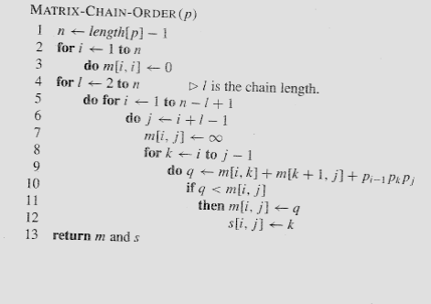
Matrix-Chain-Order(p)
O(N³)

Slide 43
4. Construct the Optimal Solution
In a similar matrix s we keep the optimal values of k
s[i, j] = a value of k such that an optimal parenthesization of A_{i..j} splits the product between A_{k} and A_{k+1}
1
2
3
n
n
 |  | k
j
3
2
1

Slide 44
4. Construct the Optimal Solution
s[1, n] is associated with the entire product A_{1..n}
  The final matrix multiplication will be split at k = s[1, n]
  A_{1..n} = A_{1..s[1, n]} ⋅ A_{s[1, n]+1..n}
  For each subproduct recursively find the corresponding value of k that results in an optimal parenthesization
1
2
3
n
n
j
3
2
1

Slide 45
4. Construct the Optimal Solution
s[i, j] = value of k such that the optimal parenthesization of A_{i} A_{i+1} ⋅⋅⋅ A_{j} splits the product between A_{k} and A_{k+1}
1
2
3
4
5
6
6
3 | 3 | 3 | 5 | 5 | -
3 | 3 | 3 | 4 | -
3 | 3 | 3 | -
1 | 2 | -
1 | -
-
s[1, n] = 3 ⇒ A_{1..6} = A_{1..3} A_{4..6}
s[1, 3] = 1 ⇒ A_{1..3} = A_{1..1} A_{2..3}
s[4, 6] = 5 ⇒ A_{4..6} = A_{4..5} A_{6..6}
5
4
3
j
2
1
i

Slide 46
4. Construct the Optimal Solution (cont.)
PRINT-OPT-PARENS(s, i, j)
if i = j
then print “A”_{i}
else print “(”
PRINT-OPT-PARENS(s, i, s[i, j])
PRINT-OPT-PARENS(s, s[i, j] + 1, j)
print “)”
1
2
3
4
5
6
6
3 | 3 | 3 | 5 | 5 | -
3 | 3 | 3 | 4 | -
3 | 3 | 3 | -
1 | 2 | -
1 | -
-
5
4
j
3
2
1
i

Slide 47
Example: A₁⋅ ⋅ ⋅A₆
(
(
A₁
(
A₂
A₃
)
)
( ( A₄ A₅ ) A₆ ) )
s[1..6, 1..6]
1
2
3
4
5
6
PRINT-OPT-PARENS(s, i, j)
if i = j
then print “A”_{i}
else print “(”
PRINT-OPT-PARENS(s, i, s[i, j])
PRINT-OPT-PARENS(s, s[i, j] + 1, j)
print “)”
6
3 | 3 | 3 | 5 | 5 | -
3 | 3 | 3 | 4 | -
3 | 3 | 3 | -
1 | 2 | -
1 | -
-
5
4
j
3
2
1
P-O-P(s, 1, 6) s[1, 6] = 3
i = 1, j = 6 “(“ P-O-P (s, 1, 3) s[1, 3] = 1
i = 1, j = 3 “(“ P-O-P(s, 1, 1) ⇒ “A₁”
P-O-P(s, 2, 3) s[2, 3] = 2
i = 2, j = 3 “(“ P-O-P (s, 2, 2) ⇒ “A₂”
P-O-P (s, 3, 3) ⇒ “A₃”
“)”
“)”
i
…

Slide 48
Memoization
Top-down approach with the efficiency of typical dynamic programming approach
Maintaining an entry in a table for the solution to each subproblem
  memoize the inefficient recursive algorithm
When a subproblem is first encountered its solution is computed and stored in that table
Subsequent “calls” to the subproblem simply look up that value

Slide 49
Memoized Matrix-Chain
Alg.: MEMOIZED-MATRIX-CHAIN(p)
n ← length[p] – 1
for i ← 1 to n
do for j ← i to n
do m[i, j] ← ∞
return LOOKUP-CHAIN(p, 1, n)
Initialize the m table with
large values that indicate
whether the values of m[i, j]
have been computed
Top-down approach

Slide 50
Memoized Matrix-Chain
Alg.: LOOKUP-CHAIN(p, i, j)
if m[i, j] < ∞
then return m[i, j]
if i = j
then m[i, j] ← 0
else for k ← i to j – 1
do q ← LOOKUP-CHAIN(p, i, k) +
LOOKUP-CHAIN(p, k+1, j) + p_{i-1}p_{k}p_{j}
if q < m[i, j]
then m[i, j] ← q
return m[i, j]
Running time is O(n³)

Slide 51
Dynamic Progamming vs. Memoization
Advantages of dynamic programming vs. memoized algorithms
  No overhead for recursion, less overhead for maintaining the table
  The regular pattern of table accesses may be used to reduce time or space requirements
Advantages of memoized algorithms vs. dynamic programming
  Some subproblems do not need to be solved

Slide 52
Matrix-Chain Multiplication - Summary
Both the dynamic programming approach and the memoized algorithm can solve the matrix-chain multiplication problem in O(n³)
Both methods take advantage of the overlapping subproblems property
There are only Θ(n²) different subproblems
  Solutions to these problems are computed only once
Without memoization the natural recursive algorithm runs in exponential time

Slide 53
Elements of Dynamic Programming
Optimal Substructure
  An optimal solution to a problem contains within it an optimal solution to subproblems
  Optimal solution to the entire problem is build in a bottom-up manner from optimal solutions to subproblems
Overlapping Subproblems
  If a recursive algorithm revisits the same subproblems over and over ⇒ the problem has overlapping subproblems

Slide 54
Rod Cutting Problem
We are given prices p_{i} and rods of length i:
Question: We are given a rod of length n, and want to maximize revenue, by cutting up the rod into pieces and selling each of the pieces.
Example: we are given a 4 inches rod. Best solution to cut up? We’ll first list the solutions:
length i 1 2 3 4 5 6 7 8 9 10
price p_{i}
1 5 8 9 10 17 17 20 24 30

Slide 55








We’ll first list all possible solutions:
1.) Cut into 2 pieces of length 2:
2.) Cut into 4 pieces of length 1:
3-4.) Cut into 2 pieces of length 1 and 3 (3 and 1):
5.) Keep length 4:
6-8.) Cut into 3 pieces, length 1, 1 and 2 (and all the different orders)
Total: 8 cases for n = 4 (= 2^{n-1}). We can slightly reduce by always requiring cuts in non-decreasing order. But still a lot!
length i 1 2 3 4 5 6 7 8 9 10
price p_{i}
1 5 8 9 10 17 17 20 24 30

Slide 56
Note: We’ve computed a brute force solution; all possibilities for this simple small example. But we want more efficient solution!
One solution:
What are we doing?
    Cut rod into length i and n-i
    Only remainder n-i can be further cut (recursed)
i
n-i

Slide 57
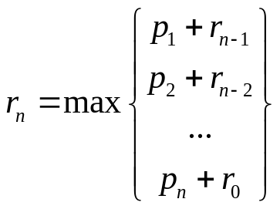
We need to define:
a.) Maximum revenue for log of size n: r_{n} (that is the solution we want to find).
b.) Revenue (price) for single log of length i: p_{i}
i
n-i
r_{n}: p_{i} + r_{n-i}

Slide 58
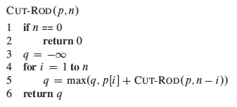
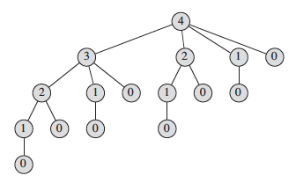
Problem? Slow runtime (it’s essential brute force)!
But why? Cut-rod calls itself repeatedly with the same parameter values (tree):

Slide 59
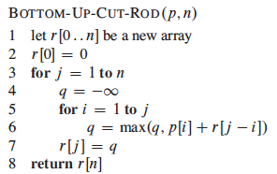
Bottom-up solution: Bottom Up Cut-Rod
For saving solution of subproblem
Compute maximum revenue
for r[j].
Saving value

Slide 60
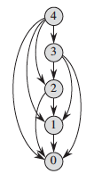
Dependency Tree
each vertex represents subproblem of a given size
Vertex label: subproblem size
Edges from x to y: We need a solution for subproblem x when solving subproblem y

Slide 61
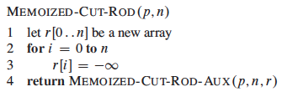
Memoized Approach
Step 1 Initialization

Slide 62
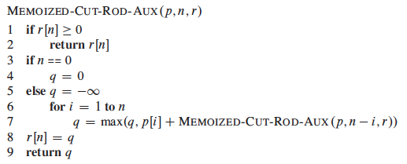

Slide 63
Longest Common Subsequence
Given two sequences
X = ⟨x₁, x₂, …, x_{m}⟩
Y = ⟨y₁, y₂, …, y_{n}⟩
find a maximum length common subsequence (LCS) of X and Y
E.g.:
X = ⟨A, B, C, B, D, A, B⟩
Subsequences of X:
  A subset of elements in the sequence taken in order
⟨A, B, D⟩, ⟨B, C, D, B⟩, etc.

Slide 64
Example
X = ⟨A, B, C, B, D, A, B⟩ X = ⟨A, B, C, B, D, A, B⟩
Y = ⟨B, D, C, A, B, A⟩ Y = ⟨B, D, C, A, B, A⟩
⟨B, C, B, A⟩ and ⟨B, D, A, B⟩ are longest common subsequences of X and Y (length = 4)
⟨B, C, A⟩, however is not a LCS of X and Y

Slide 65
Brute-Force Solution
For every subsequence of X, check whether it’s a subsequence of Y
There are 2^{m} subsequences of X to check
Each subsequence takes Θ(n) time to check
  scan Y for first letter, from there scan for second, and so on
Running time: Θ(n2^{m})

Slide 66
Making the choice
X = ⟨A, B, D, E⟩
Y = ⟨Z, B, E⟩
Choice: include one element into the common sequence (E) and solve the resulting subproblem
X = ⟨A, B, D, G⟩
Y = ⟨Z, B, D⟩
Choice: exclude an element from a string and solve the resulting subproblem

Slide 67
Notations
Given a sequence X = ⟨x₁, x₂, …, x_{m}⟩ we define the i-th prefix of X, for i = 0, 1, 2, …, m
X_{i} = ⟨x₁, x₂, …, x_{i}⟩
c[i, j] = the length of a LCS of the sequences X_{i} = ⟨x₁, x₂, …, x_{i}⟩ and Y_{j} = ⟨y₁, y₂, …, y_{j}⟩

Slide 68
A Recursive Solution
Case 1: x_{i} = y_{j}
e.g.: X_{i} = ⟨A, B, D, E⟩
Y_{j} = ⟨Z, B, E⟩
  Append x_{i} = y_{j} to the LCS of X_{i-1} and Y_{j-1}
  Must find a LCS of X_{i-1} and Y_{j-1} ⇒ optimal solution to a problem includes optimal solutions to subproblems
c[i, j] =
c[i - 1, j - 1] + 1

Slide 69
A Recursive Solution
Case 2: x_{i} ≠ y_{j}
e.g.: X_{i} = ⟨A, B, D, G⟩
Y_{j} = ⟨Z, B, D⟩
  Must solve two problems
    find a LCS of X_{i-1} and Y_{j}: X_{i-1} = ⟨A, B, D⟩ and Y_{j} = ⟨Z, B, D⟩
    find a LCS of X_{i} and Y_{j-1}: X_{i} = ⟨A, B, D, G⟩ and Y_{j} = ⟨Z, B⟩
Optimal solution to a problem includes optimal solutions to subproblems
c[i, j] =
max { c[i - 1, j], c[i, j-1] }

Slide 70
Overlapping Subproblems
To find a LCS of X and Y
  we may need to find the LCS between X and Y_{n-1} and that of X_{m-1} and Y
  Both the above subproblems has the subproblem of finding the LCS of X_{m-1} and Y_{n-1}
Subproblems share subsubproblems

Slide 71
3. Computing the Length of the LCS
  0 if i = 0 or j = 0
  c[i, j] = c[i-1, j-1] + 1 if x_{i} = y_{j}
  max(c[i, j-1], c[i-1, j]) if x_{i} ≠ y_{j}
0
1
2
n
y_{j:}
y₁
y₂
y_{n}
0
x_{i}
0 | 0 | 0 | 0 | 0 | 0
0
0
0
0
0
1
x₁
first
2
x₂
second
i
m
x_{m}
j

Slide 72
Additional Information
  0 if i,j = 0
c[i, j] = c[i-1, j-1] + 1 if x_{i} = y_{j}
  max(c[i, j-1], c[i-1, j]) if x_{i} ≠ y_{j}
A matrix b[i, j]:
For a subproblem [i, j] it tells us what choice was made to obtain the optimal value
If x_{i} = y_{j}
b[i, j] = “ ”
Else, if c[i - 1, j] ≥ c[i, j-1]
b[i, j] = “ ↑ ”
else
b[i, j] = “ ← ”
b & c:
0
1
2
3
n
y_{j:}
A
C
D
F
0
x_{i}
0 | 0 | 0 | 0 | 0 | 0
0
0
0
0
0
1
A
2
B
c[i-1,j]
i
3
C
c[i,j-1]
m
D
j

Slide 73
LCS-LENGTH(X, Y, m, n)
for i ← 1 to m
do c[i, 0] ← 0
for j ← 0 to n
do c[0, j] ← 0
for i ← 1 to m
do for j ← 1 to n
do if x_{i} = y_{j}
then c[i, j] ← c[i - 1, j - 1] + 1
b[i, j ] ← “ ”
else if c[i - 1, j] ≥ c[i, j - 1]
then c[i, j] ← c[i - 1, j]
b[i, j] ← “↑”
else c[i, j] ← c[i, j - 1]
b[i, j] ← “←”
return c and b
The length of the LCS if one of the sequences
is empty is zero
Case 1: x_{i} = y_{j}
Case 2: x_{i} ≠ y_{j}
Running time: Θ(mn)

Slide 74
Example
  0 if i = 0 or j = 0
  c[i, j] = c[i-1, j-1] + 1 if x_{i} = y_{j}
  max(c[i, j-1], c[i-1, j]) if x_{i} ≠ y_{j}
X = ⟨A, B, C, B, D, A⟩
Y = ⟨B, D, C, A, B, A⟩
0
1
2
3
4
5
6
If x_{i} = y_{j}
b[i, j] = “ ”
Else if c[i - 1, j] ≥ c[i, j-1]
b[i, j] = “ ↑ ”
else
b[i, j] = “ ← ”
y_{j}
B
D
C
A
B
A
0
x_{i}
0
0
0
0
0
0
0
1
A
0
↑
0
↑
0
↑
0
1
1
←1
2
B
0
1
↑
1
2
←1
←1
←2
3
C
0
↑
1
↑
1
2
↑
2
↑
2
←2
4
B
0
1
↑
1
↑
2
↑
2
3
←3
5
D
0
↑
1
2
↑
2
↑
2
↑
3
↑
3
6
A
0
↑
1
↑
2
↑
2
3
↑
3
4
7
B
0
1
↑
2
↑
2
↑
3
4
↑
4

Slide 75
4. Constructing a LCS
Start at b[m, n] and follow the arrows
When we encounter a “ “ in b[i, j] ⇒ x_{i} = y_{j} is an element of the LCS
0
1
2
3
4
5
6
y_{j}
B
D
C
A
B
A
0
x_{i}
0
0
0
0
0
0
0
1
A
0
↑
0
↑
0
↑
0
1
1
←1
2
B
0
1
↑
1
2
←1
←1
←2
3
C
0
↑
1
↑
1
2
↑
2
↑
2
←2
4
B
0
1
↑
1
↑
2
↑
2
3
←3
5
D
0
↑
1
2
↑
2
↑
2
↑
3
↑
3
6
A
0
↑
1
↑
2
↑
2
3
↑
3
4
7
B
0
1
↑
2
↑
2
↑
3
4
↑
4

Slide 76
PRINT-LCS(b, X, i, j)
if i = 0 or j = 0
then return
if b[i, j] = “ ”
then PRINT-LCS(b, X, i - 1, j - 1)
print x_{i}
elseif b[i, j] = “↑”
then PRINT-LCS(b, X, i - 1, j)
else PRINT-LCS(b, X, i, j - 1)
Initial call: PRINT-LCS(b, X, length[X], length[Y])
Running time: Θ(m + n)

Slide 77
Memoized Approach
LCS(X,Y,i,j,C) {
if (i == 0 || j == 0)
return 0;
if (C[i][j] != -∝)
return C[i][j];
if (X[i] == Y[j])
C[i][j] = 1 + LCS(X, Y, i - 1, j - 1, C);
else
C[i][j] = max(LCS(X, Y, i, j - 1, C),LCS(X, Y, i - 1, j, C));
return C[i][j];
}

Slide 78
Memoized Approach
LCS(X,Y,I,j,C) {
if (i == 0 || j == 0)
return 0;
if (C[i][j] != -∝)
return C[i][j];
if (X[i] == Y[j])
C[i][j] = 1 + LCS(X, Y, i - 1, j - 1, C);
B[i][j]=‘ ‘;
else x1=LCS(X, Y, i, j - 1, C); y1= LCS(X, Y, i - 1, j, C);
C[i][j] = max(x1,y1);
if (x1>=y1) B[i][j]=‘ ‘; else B[i][j]= ‘ ‘;
return C[i][j];
}

Slide 79
Optimal Binary Search Trees
Problem
  Given sequence K = k₁ < k₂ <··· < k_{n} of n sorted keys,
  with a search probability p_{i} for each key k_{i}.
  Want to build a binary search tree (BST)
  with minimum expected search cost.
  Actual cost = # of items examined.
  For key k_{i}, cost = depth_{T}(k_{i})+1, where depth_{T}(k_{i}) = depth of k_{i} in BST T .

Slide 80
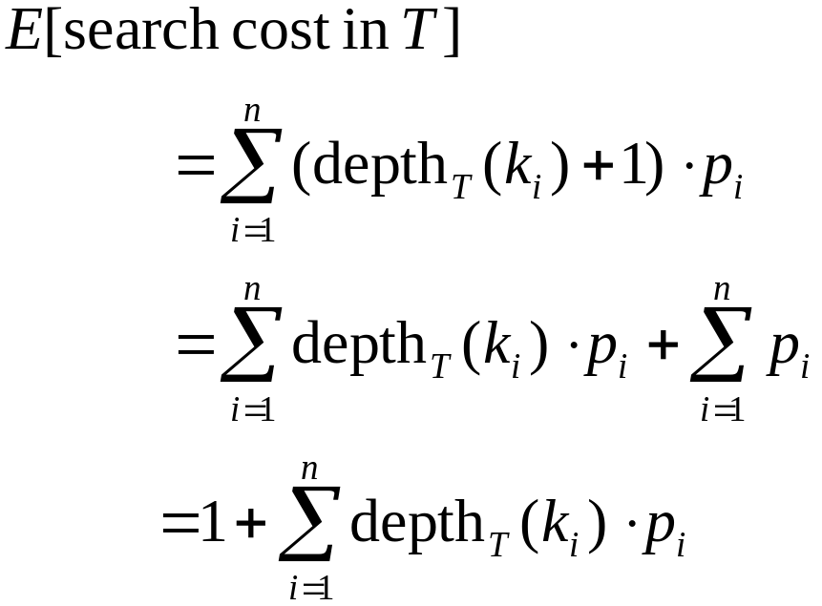
Expected Search Cost
Sum of probabilities is 1.
(1)

Slide 81
Example
Consider 5 keys with these search probabilities:
p₁ = 0.25, p₂ = 0.2, p₃ = 0.05, p₄ = 0.2, p₅ = 0.3.
k₂
i depth_{T}(k_{i}) depth_{T}(k_{i})·p_{i}
1 1 0.25
2 0 0
3 2 0.1
4 1 0.2
5 2 0.6
1.15
k₁
k₄
k₃
k₅
Therefore, E[search cost] = 2.15.

Slide 82
Example
p₁ = 0.25, p₂ = 0.2, p₃ = 0.05, p₄ = 0.2, p₅ = 0.3.
k₂
i depth_{T}(k_{i}) depth_{T}(k_{i})·p_{i}
1 1 0.25
2 0 0
3 3 0.15
4 2 0.4
5 1 0.3
1.10
k₁
k₅
k₄
Therefore, E[search cost] = 2.10.
k₃
This tree turns out to be optimal for this set of keys.

Slide 83
Example
Observations:
  Optimal BST may not have smallest height.
  Optimal BST may not have highest-probability key at root.
Build by exhaustive checking?
  Construct each n-node BST.
  For each,
  assign keys and compute expected search cost.
  But number of different BSTs with n nodes is exponential.

Slide 84
Optimal Substructure
Any subtree of a BST contains keys in a contiguous range k_{i}, ..., k_{j} for some 1 ≤ i ≤ j ≤ n.
If T is an optimal BST and
T contains subtree T′ with keys k_{i}, ... ,k_{j} ,
then T′ must be an optimal BST for keys k_{i}, ..., k_{j}.
Proof: Cut and paste.
T
T′

Slide 85
Optimal Substructure
One of the keys in k_{i}, …,k_{j}, say k_{r}, where i ≤ r ≤ j,
must be the root of an optimal subtree for these keys.
Left subtree of k_{r} contains k_{i},...,k_{r−1}.
Right subtree of k_{r} contains k_{r}+1, ...,k_{j}.
To find an optimal BST:
  Examine all candidate roots k_{r} , for i ≤ r ≤ j
  Determine all optimal BSTs containing k_{i},...,k_{r−1} and containing k_{r+1},...,k_{j}
k_{r}
k_{i}
k_{r-1}
k_{r+1}
k_{j}

Slide 86
Recursive Solution
Find optimal BST for k_{i},...,k_{j}, where i ≥ 1, j ≤ n, j ≥ i−1. When j = i−1, the tree is empty.
Define e[i, j ] = expected search cost of optimal BST for k_{i},...,k_{j}.
If j = i−1, then e[i, j ] = 0.
If j ≥ i,
  Select a root k_{r}, for some i ≤ r ≤ j .
  Recursively make an optimal BSTs
    for k_{i},..,k_{r−1} as the left subtree, and
    for k_{r+1},..,k_{j} as the right subtree.

Slide 87
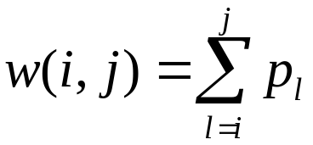
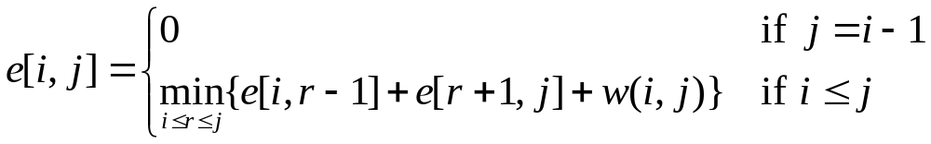
Recursive Solution
When the OPT subtree becomes a subtree of a node:
  Depth of every node in OPT subtree goes up by 1.
  Expected search cost increases by
If k_{r} is the root of an optimal BST for k_{i},..,k_{j} :
  e[i, j ] = p_{r} + (e[i, r−1] + w(i, r−1))+(e[r+1, j] + w(r+1, j))
  = e[i, r−1] + e[r+1, j] + w(i, j).
But, we don’t know k_{r}. Hence,
from (1)
(because w(i, j)=w(i,r−1) + p_{r} + w(r + 1, j))

Slide 88
Computing an Optimal Solution
For each subproblem (i,j), store:
expected search cost in a table e[1 ..n+1 , 0 ..n]
  Will use only entries e[i, j ], where j ≥ i−1.
root[i, j ] = root of subtree with keys k_{i},..,k_{j}, for 1 ≤ i ≤ j ≤ n.
w[1..n+1, 0..n] = sum of probabilities
  w[i, i−1] = 0 for 1 ≤ i ≤ n.
  w[i, j ] = w[i, j-1] + p_{j} for 1 ≤ i ≤ j ≤ n.

Slide 89
Pseudo-code
OPTIMAL-BST(p, q, n)
for i ← 1 to n + 1
do e[i, i− 1] ← 0
w[i, i− 1] ← 0
for l ← 1 to n
do for i ← 1 to n−l + 1
do j ←i + l−1
e[i, j ]←∞
w[i, j ] ← w[i, j−1] + p_{j}
for r ←i to j
do t ← e[i, r−1] + e[r + 1, j ] + w[i, j ]
if t < e[i, j ]
then e[i, j ] ← t
root[i, j ] ←r
return e and root
Consider all trees with l keys.
Fix the first key.
Fix the last key
Determine the root
of the optimal
(sub)tree
Time: O(n³)

Slide 90
Number of Subsequences with Even and Odd Sum
Input: arr[] = {1, 2, 2, 3}
Output: EvenSum = 7, OddSum = 8
There are 2^{N} -1 total subsequences
Sequences with Even sum
1. {1, 3} Sum =4
2. {1, 2, 2, 3} Sum =8
3-4. {1, 2, 3} {1, 2, 3} Sum =6
5-6. {2} {2} Sum =2
7. {2, 2} Sum=4
And the rest subsequences are of odd sum

Slide 91
Naïve Approach
Generate all subsequences and check if the subsequence is odd or even
Not Efficient!!

Slide 92
Dynamic Programming Approach
CntEvn[i] → number of subsequences with even sum in the range of (0,i)
CntOdd[i] → number of subsequences with odd sum in the range of (0,i)

Slide 93
For odd number in i^{th} position
CntEvn[i] = CntEvn[i-1] + CntOdd[i-1]
CntOdd[i] = CntEvn[i-1] + CntOdd[i-1] + 1
For even number in i^{th} position
CntEvn[i] = CntEvn[i-1] + CntEvn[i-1] + 1
CntOdd[i] = CntOdd[i-1] + CntOdd[i-1]

Slide 94
Base Condition:
CntEvn[0] = 0
CntOdd[0] = 0

Slide 95
For i -> 1 to n
  if (A[i]%2 == 0)
    CntEvn[i] = CntEvn[i-1] + CntEvn[i-1] + 1
    CntOdd[i] = CntOdd[i-1] + CntOdd[i-1]
  else
    CntEvn[i] = CntEvn[i-1] + CntOdd[i-1]
    CntOdd[i] = CntEvn[i-1] + CntOdd[i-1] + 1
return

Slide 96
Typedef struct s{
  int even;
  Int odd;
  } X
X Cnt[n+1]
For i → 1 to n
  X[i].even = -∝
  X[i].odd = -∝
FindCnt(A, Cnt, n)

Slide 97
FindCnt(A, Cnt, n)
X tmp;
if (Cnt [n].even >= 0)
  return Cnt[n];
else
  tmp= FindCnt(A, Cnt, n-1) ;
  If (A[n]%2 == 0)
    Cnt[n].even = 2*tmp.even +1;
    Cnt[n].odd = 2*tmp.odd;
  else
    Cnt[n].even = tmp.even + tmp.odd
    Cnt[n].odd = tmp.even + tmp.odd +1
  return Cnt[n];

